Slide 1

Attack Detection and Autonomous mitigation
through Agentic AI
Detection of Cyber attacks like DDOS , BOTs , other Anomalies and attacks , complemented by the Agentic Gen-AI to automate the process of giving insights and mitigation measures .

Slide 2
Scope
Lack of explainability: Current models fall short in offering detailed explanations for their predictions, specifically in delineating the rationale for identifying traffic as malicious. While shallow models like decision trees or linear regression can highlight influential traffic features through feature importance analysis, these features are manually curated, demanding substantial human effort and potentially lacking comprehensiveness. This deficiency in explainability hinders the broader adoption of existing AI models, often perceived as black boxes, in industrial settings.
Lack of mitigation instructions: Existing models, designed primarily for classification or regression, lack the capability to generate actionable mitigation instructions, such as Access Control List (ACL) configurations, for DDoS attacks. Moreover, the capabilities, configuration methods, and commands accepted by different attack mitigation devices differ significantly, posing a challenge in generating tailored mitigation instructions for each device.
These limitations render AI models efficient yet impractical and unusable in real-world scenarios. The emergence of LLMs may address these challenges, which motivates the research presented in this work

Slide 3
Progress ( Nikhil )
Learnt the basics of DDOS attacks and its different types :
DNS Amplification Attack , and how the DNS lookup works
SYN flood attack and how it works , and also how we can reroute to a honeypot if attack detected
Researched papers that implemented DDOS detection and mitigation through generative AI and deep learning
Came up with a basic flow chart on how we could implement a hybrid Deep learning and Gen AI model to detect and mitigate against attacks
Learnt about Bots and their patterns and how to recognize Good bots from Bad Bots
Learned specifically the patterns of bad bots , that ignore rules and keep flooding the application with requests
Learnt about python frameworks like scapy and pyshark that help in network traffic analysis and packet manipulation and did a short course on using the scapy CLI for packet sniffing and summarization and reading from pcap ( packet capture files ) for further network analysis .
Looking into MCP servers and how to integrate them with langchain ( specifically to use in the future for cyber security MCP servers )
Megha , Pratul and I talked about the final product and he approved the flowchart and the architecture of the Hybrid agent ( deep learning + gen AI agent )

Slide 4
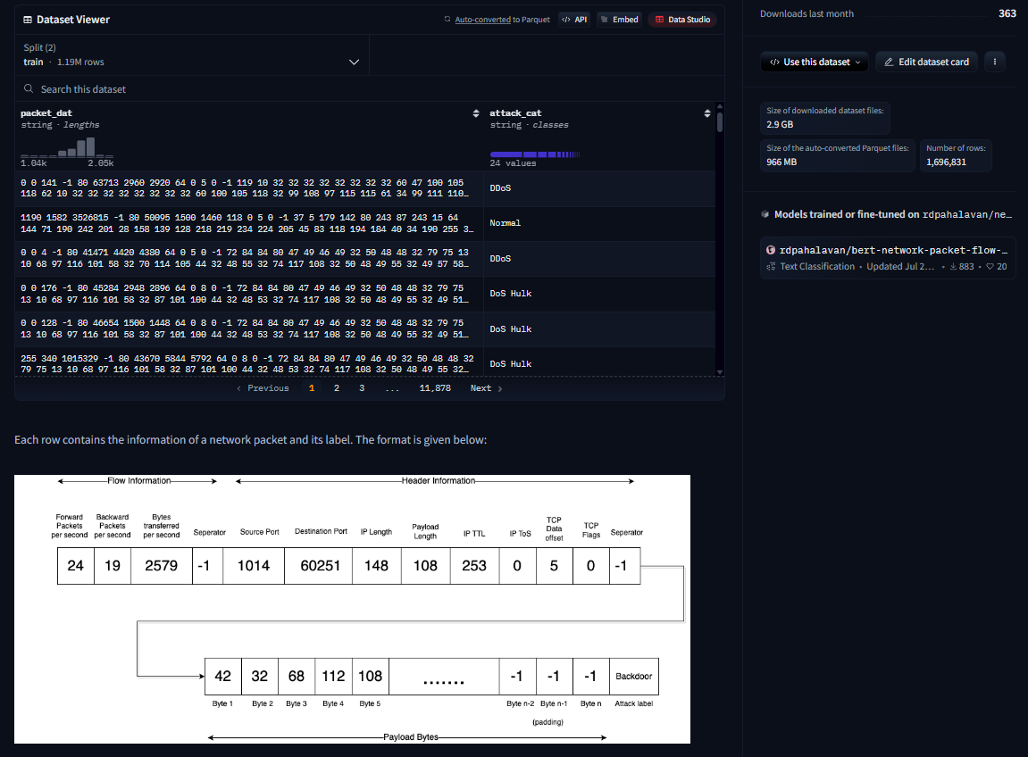
Progress ( Nikhil )
Features required as input to the Deep learning Attack detection model , will be captured using python tools such as scapy , pyshark and we are currently looking into that
also.

Slide 5
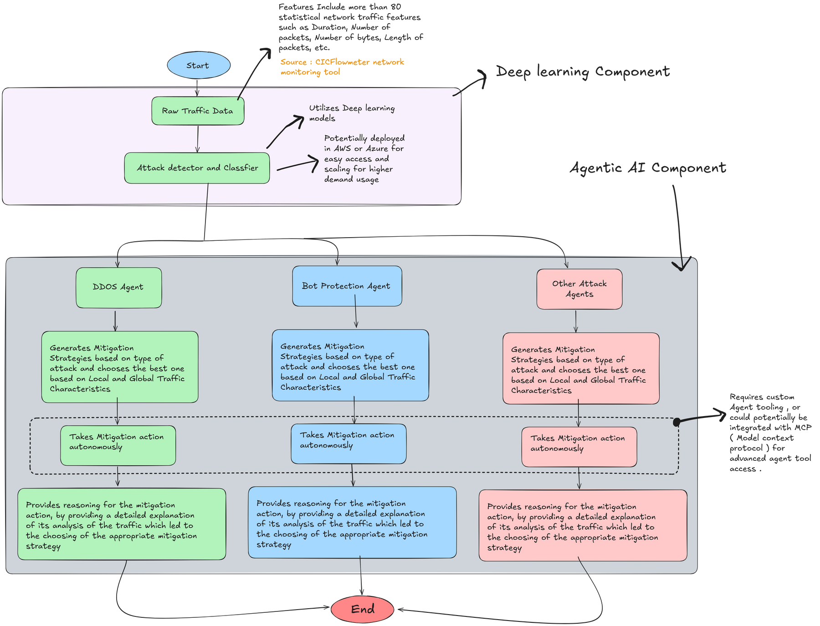
Progress ( Nikhil )

Slide 6
Key Points
Using a Hybrid strategy including Deep learning and Generative AI ensures low latency detection through Deep learning models and the autonomous mitigation measures and insight generation .
Unlike other Firewalls , this strategy includes Detection + Mitigation + Reasoning behind mitigative measures taken , which could serve as a major USP .
Its best if we keep each attack agent separate as it allows us to individually fine tune each agent to become better at mitigating each type of attack , instead of generalizing a single agent to all types of attacks . Therefore resulting in better mitigation efficacy .

Slide 7
Progress ( Megha )
Cybersecurity Context (WAF & Anomaly Detection)
Protect web applications from malicious traffic, especially attacks like:
SQL Injection
Cross-site Scripting (XSS)
Command Injection
Path Traversal
Detect anomalous behavior (unknown or zero-day attacks) not covered by static rules.
Traditional WAF Limitations
Signature-based detection fails for new/obfuscated threats.
No adaptability or learning from traffic patterns
2) Why AI / LLMs Enhance WAF?
LLMs are useful because:
Can understand context of requests (like a sentence).
Detect malicious intent even with encoded/obfuscated payloads.
Transfer learning (pretrained BERT) helps with small datasets.
Traditional WAF | AI/LLM based WAF
Rule-based | Context-aware
Needs manual updates | Learns patterns
Static defense | Adaptive defense
Weak against unknown | Can detect anomalies

Slide 8
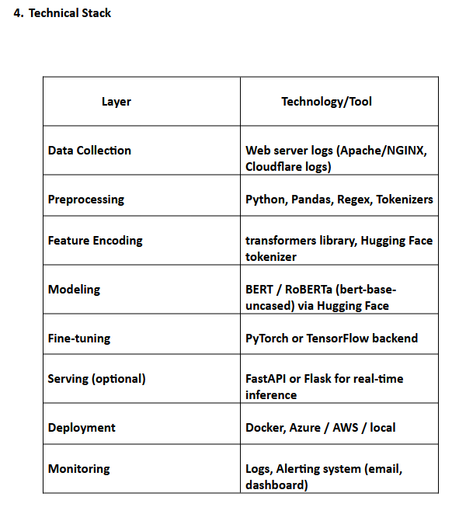
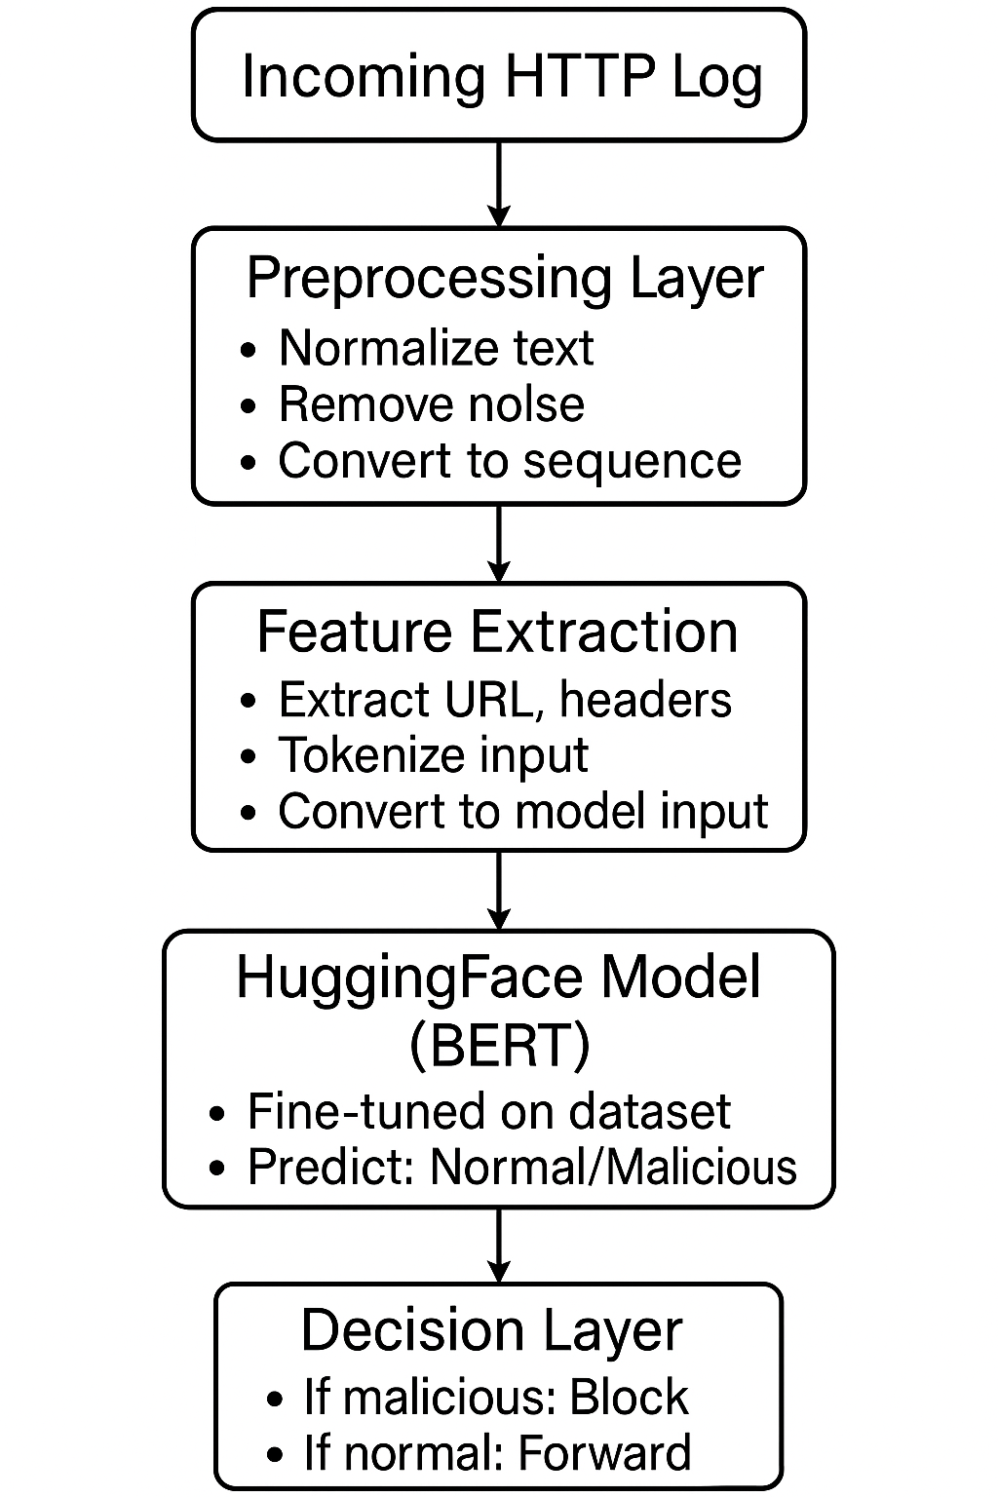
Progress ( Megha )
Architecture: AI Agent for WAF & Anomaly Detection

Slide 9
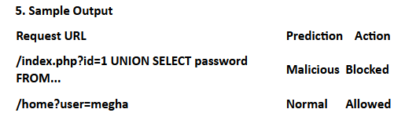
Progress ( Megha )
Before this, I studied the OWASP Top 10, traditional WAF rules, and how logs are structured (URL, method, headers). Then I learned about LLMs, tokenization, and fine-tuning using Hugging Face. This helped me understand how to convert web traffic into model-readable format for AI-based detection.

Slide 10
Notes from Pratul
Pratul gave Megha and I suggestions about courses from platforms like Deeplearning.ai and the official tutorials for LangChain
He also validated and approved the basic flowchart we created for the agent
He suggested to go to Hugging face to find the Deep learning model ( looking into that now )

Slide 11
Plan
1. Preparing Network capture tool and Dataset
Clean and filter dataset for unwanted and Unnecessary values and features
Selection of features using PCA or other feature selection methods
Scaling dataset to be fed into the Deep learning model
Applying the above changes to all the different attack datasets and concatenating them for further shuffling and train - test splitting .
2. Developing the Attack classification model
Research and find an architecture with proven high accuracy scores and low latency numbers
developing the architecture in AWS and preparing for training

Slide 12
Plan
3. Training/Fine-tuning detector model
Batchwise training of the detector model
closely monitoring the model training
4. Testing the model
Testing the model on real or generated traffic data to see if it accurately identifies and classifies the attack
If accuracy scores aren’t high enough or latency isn’t low enough we reiterate from step 2 to 4 , where we restructure or use a different deep learning model that could potentially satisfy our needs.

Slide 13
Plan
5. Designing LangGraph Agent
Design agent workflow using LangGraph
6. Design Agent Tooling for Autonomous mitigation actions
7. Compile Agent Workflow with tools
8. Test and Fine tune agent
9. Test Agent and reiterate from step 5 to 8 if agent Graph requires modification
10. Deploy and Integrate

